Slide 1
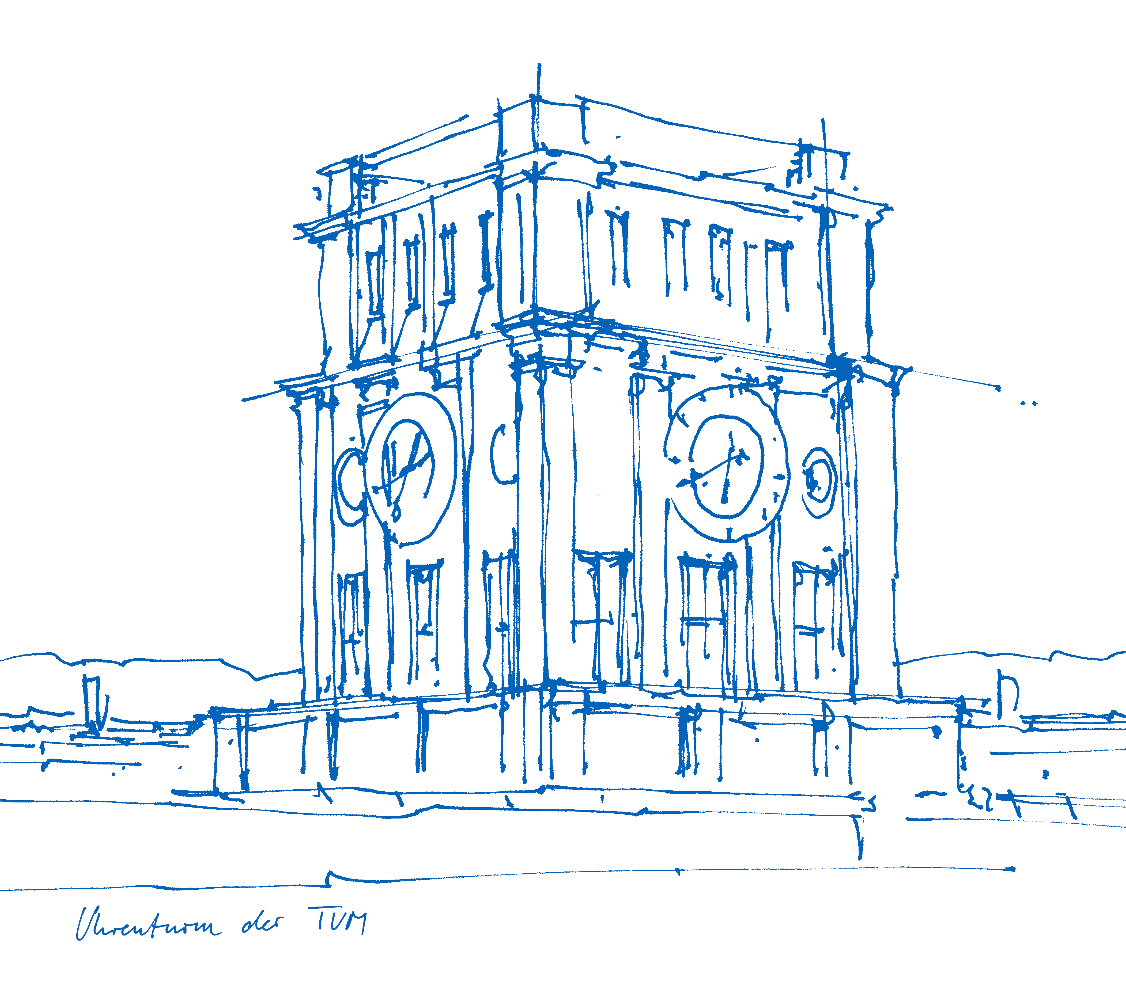
Robocup@Home Final Project Serving Drinks
Members: Huiwen Pan
Xianrui Niu
Zhiyi Li
Group: GSW Champ
Technical University of Munich
Chair for Cognitve Systems
Munich, 17. July 2019

Slide 2
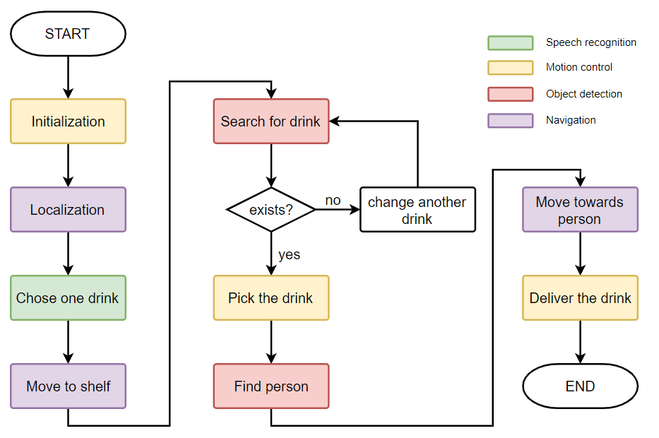
Pipeline

Slide 3
Motion plan with octomap
Header

Slide 4
Speech recognition

Slide 5
Object detection

Slide 6
Person pose detection

Slide 7
Q&A

Slide 8
Thanks!

